Slide 1
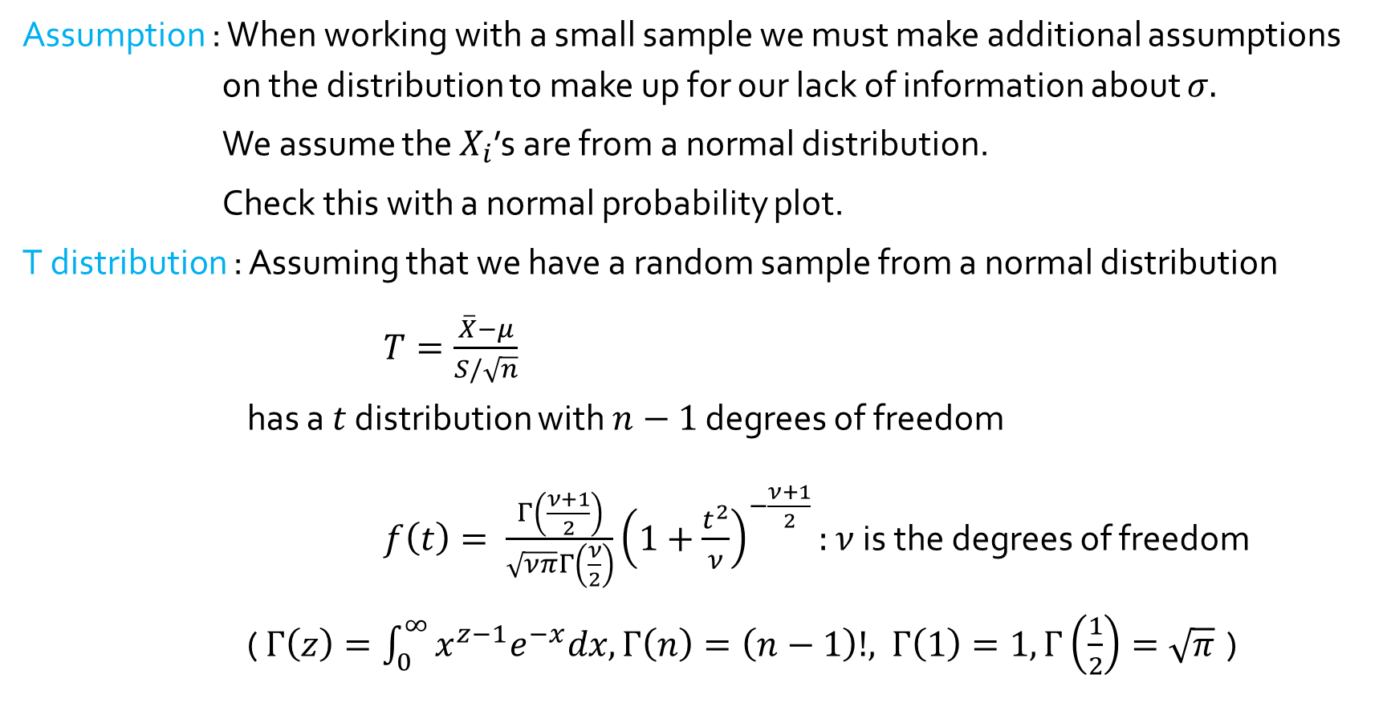
Intervals based on a Normal Distribution
Assumption : When working with a small sample we must make additional assumptions on the distribution to make up for our lack of information about $σ.$
We assume the $X_{i}$’s are from a normal distribution.
Check this with a normal probability plot.
T distribution : Assuming that we have a random sample from a normal distribution
$T=\frac{\overline{X}−μ}{S/\sqrt{n}}$
has a $t$ distribution with $n−1$ degrees of freedom
$f\left(t\right)= \frac{Γ\left(\frac{ν+1}{2}\right)}{\sqrt{νπ}Γ\left(\frac{ν}{2}\right)}{\left(1+\frac{t^{2}}{ν}\right)}^{−\frac{ν+1}{2}}:$ $ν$ is the degrees of freedom
( $Γ\left(z\right)=\int_{0}^{∞}{x^{z−1}e^{−x}dx,Γ\left(n\right)=\left(n−1\right)!, }$ $Γ\left(1\right)=1, Γ\left(\frac{1}{2}\right)=\sqrt{π}$ )

Slide 2
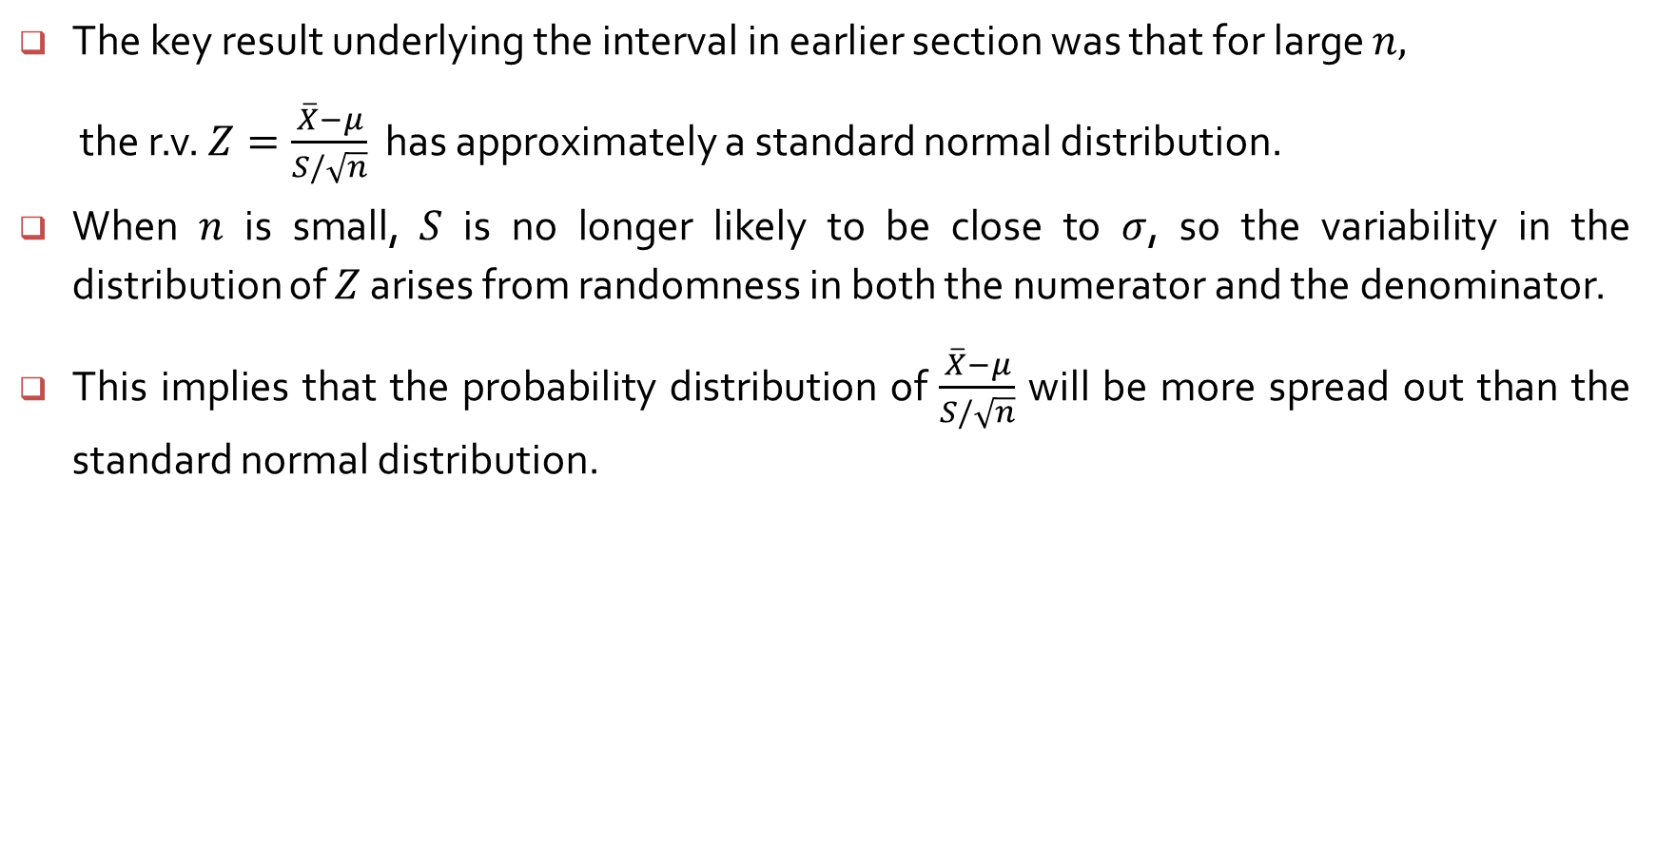
Intervals based on a Normal Population Distribution
The key result underlying the interval in earlier section was that for large $n,$
the r.v. $Z=\frac{\overline{X}−μ}{S/\sqrt{n}}$ has approximately a standard normal distribution.
When $n$ is small, $S$ is no longer likely to be close to $σ$, so the variability in the distribution of $Z$ arises from randomness in both the numerator and the denominator.
This implies that the probability distribution of $\frac{\overline{X}−μ}{S/\sqrt{n}}$ will be more spread out than the standard normal distribution.

Slide 3

Properties of the T distribution
Each $t_{ν}$ curve is bell-shaped and centered at 0
Each $t_{ν}$ curves is more spread out than the standard normal.
As $ν↑$, the spread of $t_{ν}$ decreases
As $ν↑∞$, $t_{ν}$ approaches the standard normal.

Slide 4
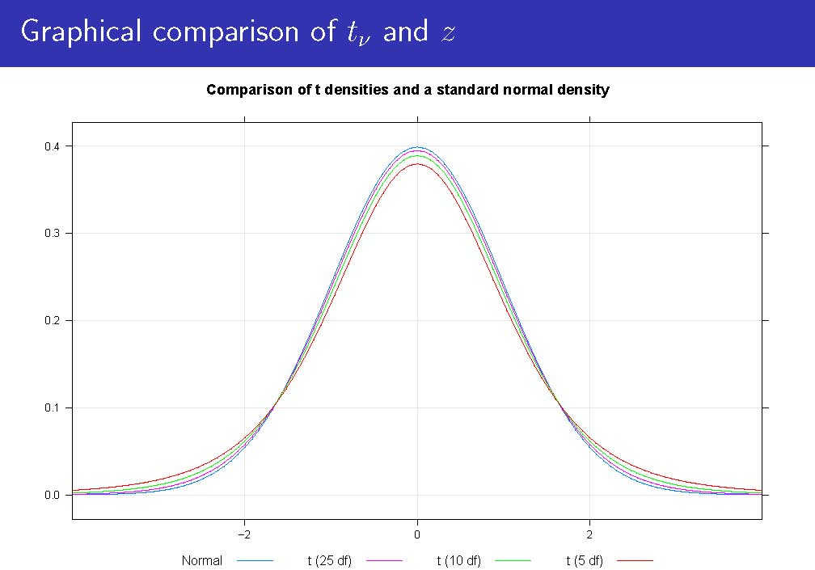

Slide 5
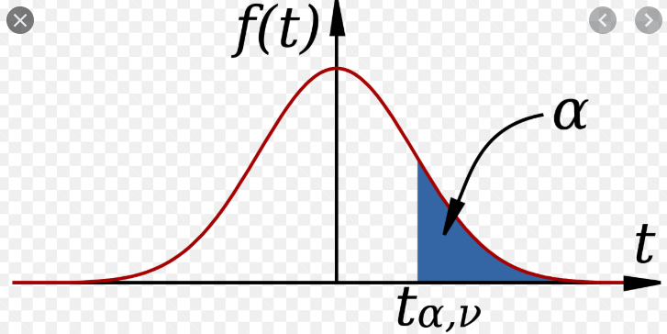
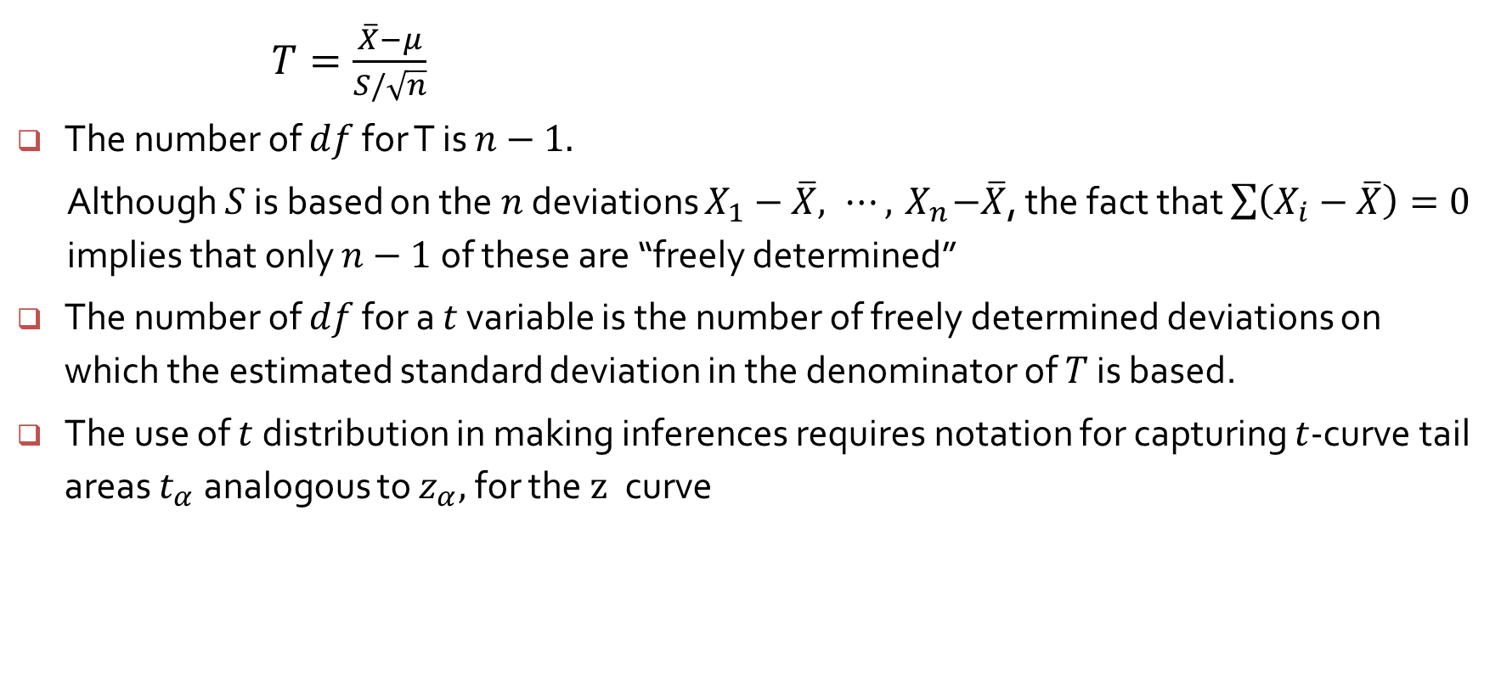
Properties of the t distribution
$T=\frac{\overline{X}−μ}{S/\sqrt{n}}$
The number of $df$ for T is $n−1.$
Although $S$ is based on the $n$ deviations $X_{1}−\overline{X}, ⋯,{ X}_{n}−\overline{X}$, the fact that $\sum{\left(X_{i}−\overline{X}\right)}=0$ implies that only $n−1$of these are “freely determined”
The number of $df$ for a $t$ variable is the number of freely determined deviations on which the estimated standard deviation in the denominator of $T$ is based.
The use of $t$ distribution in making inferences requires notation for capturing $t$-curve tail areas $t_{α}$ analogous to $z_{α},$ for the$z$curve

Slide 6
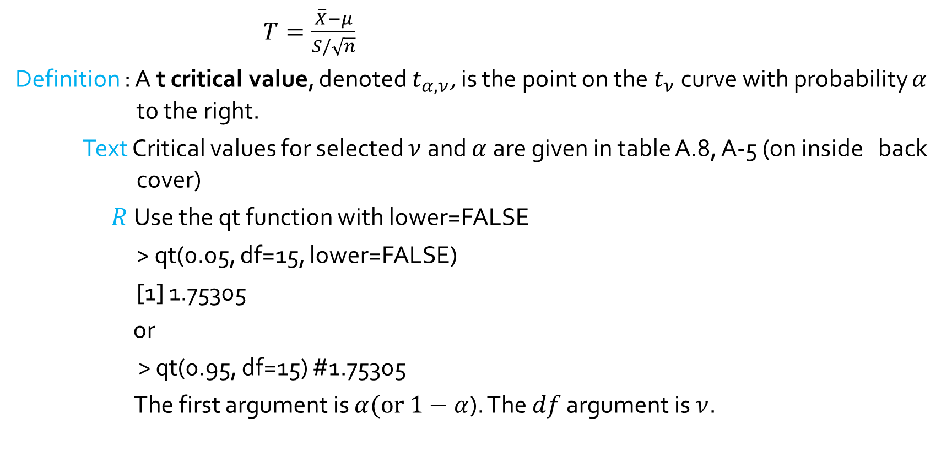
T critical values
$T=\frac{\overline{X}−μ}{S/\sqrt{n}}$
Definition : A t critical value, denoted $t_{α,ν}$, is the point on the $t_{ν}$ curve with probability $α$ to the right.
Text Critical values for selected $ν$and $α$are given in table A.8, A-5 (on inside back cover)
$R$ Use the qt function with lower=FALSE
> qt(0.05, df=15, lower=FALSE)
[1] 1.75305
or
> qt(0.95, df=15) #1.75305
The first argument is $α(or 1−$ $α$). The $df$ argument is $ν$.

Slide 7
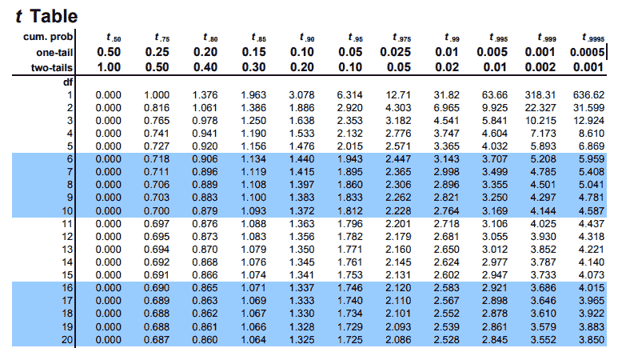

Slide 8
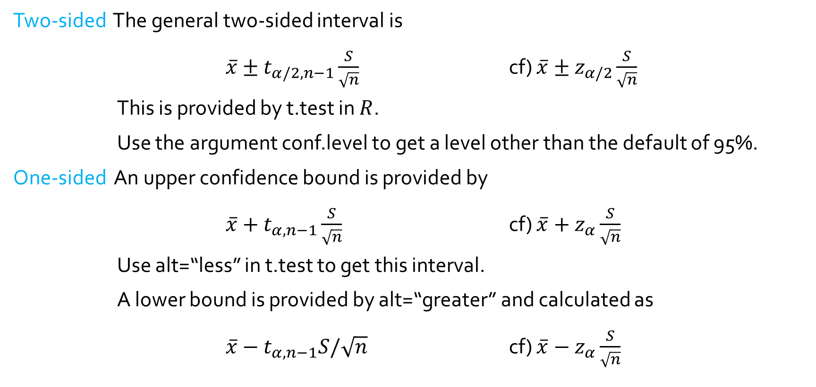
General confidence interval on $μ$
Two-sided The general two-sided interval is
$\overline{x}±t_{α/2,n−1}\frac{S}{\sqrt{n}}$ cf) $\overline{x}±z_{α/2}\frac{S}{\sqrt{n}}$
This is provided by t.test in $R$.
Use the argument conf.level to get a level other than the default of 95%.
One-sided An upper confidence bound is provided by
$\overline{x}+t_{α,n−1}\frac{S}{\sqrt{n}}$ cf) $\overline{x}+z_{α}\frac{S}{\sqrt{n}}$
Use alt=“less” in t.test to get this interval.
A lower bound is provided by alt=“greater” and calculated as
$\overline{x}−t_{α,n−1}S/\sqrt{n}$ cf) $\overline{x}−z_{α}\frac{S}{\sqrt{n}}$

Slide 9

Confidence interval when $σ$ is unknown
Two-sided interval :
$P\left(−t_{\frac{α}{2},n−1}<T=\frac{\overline{X}−μ}{S/\sqrt{n}}<t_{α/2,n−1}\right)=1−α$
$−t_{α/2,n−1}∙\frac{s}{\sqrt{n}}<\overline{X}−μ<t_{α/2,n−1}∙\frac{s}{\sqrt{n}}$
$−\overline{X}−t_{α/2,n−1}∙\frac{s}{\sqrt{n}}<−μ<−\overline{X}+t_{α/2,n−1}∙\frac{s}{\sqrt{n}}$
$\overline{X}−t_{α/2,n−1}∙\frac{s}{\sqrt{n}}<μ<\overline{X}+t_{α/2,n−1}∙\frac{s}{\sqrt{n}}$
One-sided interval :
$P\left(T=\frac{\overline{X}−μ}{S/\sqrt{n}}<t_{α,n−1}\right)=1−α$
$\overline{X}−μ<t_{α,n−1}∙\frac{s}{\sqrt{n}}$
$−μ<−\overline{X}+t_{α,n−1}∙\frac{s}{\sqrt{n}}$
$\overline{X}−t_{α,n−1}∙\frac{s}{\sqrt{n}}<μ$

Slide 10
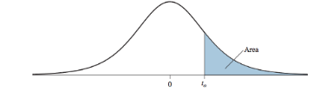
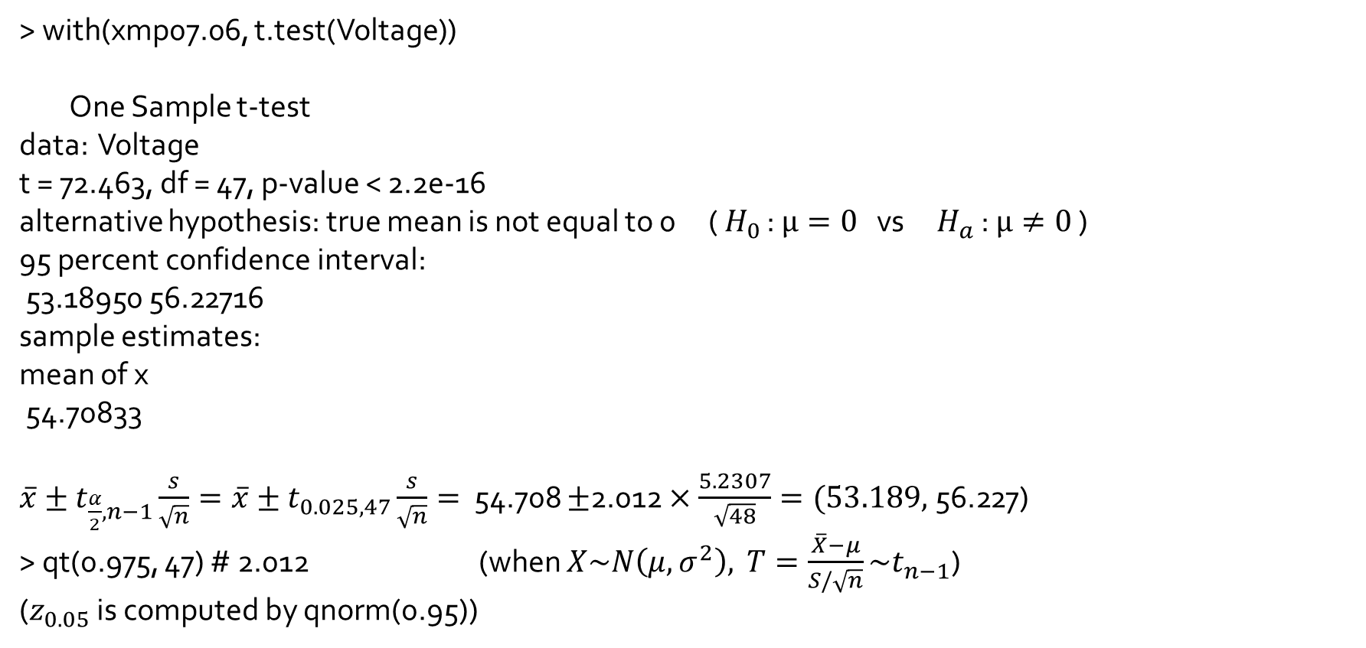
> with(xmp07.06, t.test(Voltage))
One Sample t-test
data: Voltage
t = 72.463, df = 47, p-value < 2.2e-16
alternative hypothesis: true mean is not equal to 0 ( $H_{0}$ : $μ=0$ vs $H_{a}$ : $μ≠0$ )
95 percent confidence interval:
53.18950 56.22716
sample estimates:
mean of x
54.70833
$\overline{x}±t_{\frac{α}{2},n−1}\frac{s}{\sqrt{n}}=\overline{x}±t_{0.025, 47}\frac{s}{\sqrt{n}}=$ 54.708 $±$2.012 $×\frac{5.2307}{\sqrt{48}}=(53.189,$56.227)
> qt(0.975, 47) # 2.012 (when $X\sim N\left(μ, σ^{2}\right),$ $T=\frac{\overline{X}−μ}{S/\sqrt{n}}\sim t_{n−1}$)
($z_{0.05}$ is computed by qnorm(0.95))

